Slide 1
This tutorial will show you how to Upload exams within the instructor portal for students scheduled to take them using accommodations.

Slide 2
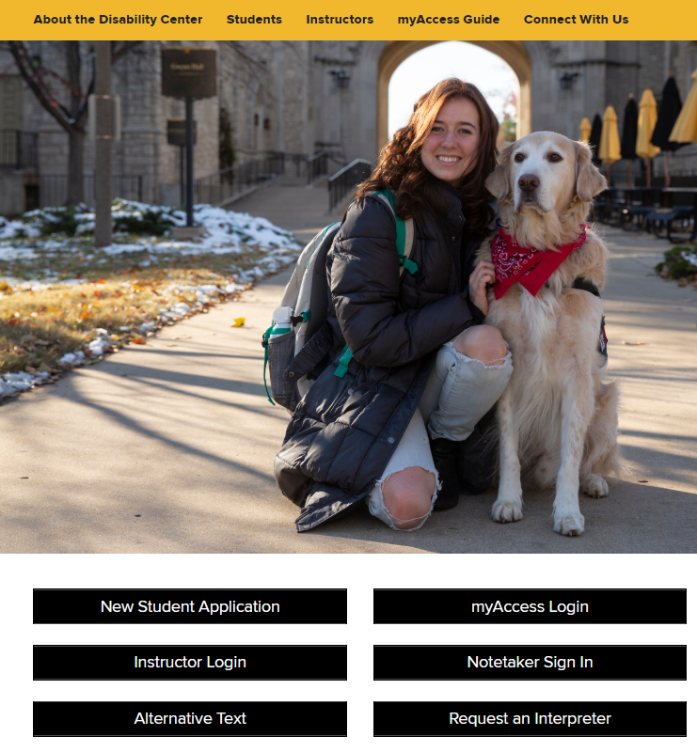
Log In to the Instructor Portal
You will find the “Instructor Login” button on the homepage of the Disability Center’s website www.disabilitycenter.missouri.edu.
You will then be prompted to log in using your University credentials.

Slide 3
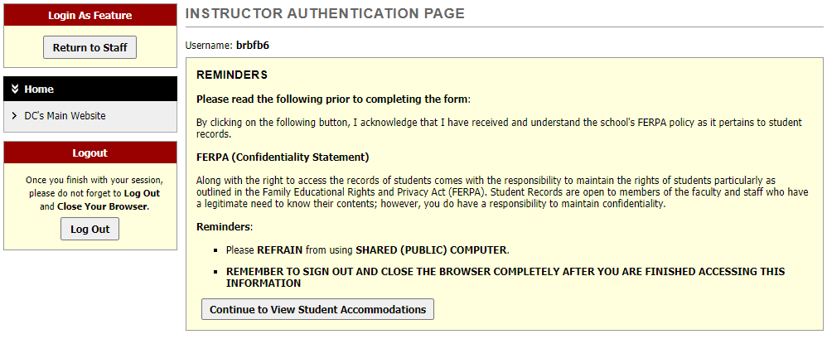
This is the homepage where it will list any important info or reminders for you. Once you have read/verified it, you can click on the “Continue to View Student Accommodations Button”.

Slide 4
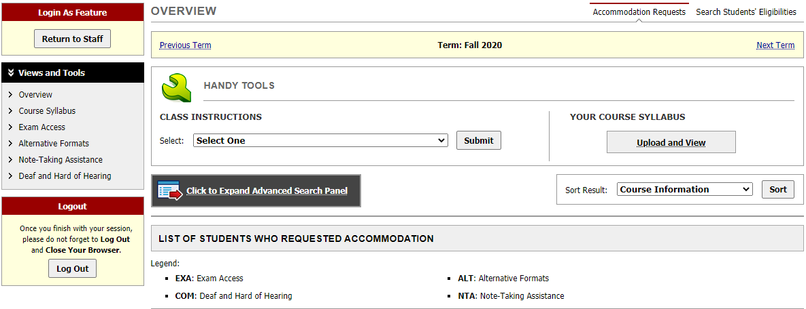
Go to the “Exam Access” section to view all exam related options and information.

Slide 5
Exam Access Agreement Section
In this section, you will want to enter in the information for your Exam Access Agreement. This is a guideline for our office as well as the students when scheduling exams through the Disability Center. To fill out the agreement, click on “Continue to Specify Exam Access Agreement”. If you have multiple courses, you will need to do this for each course.

Slide 6
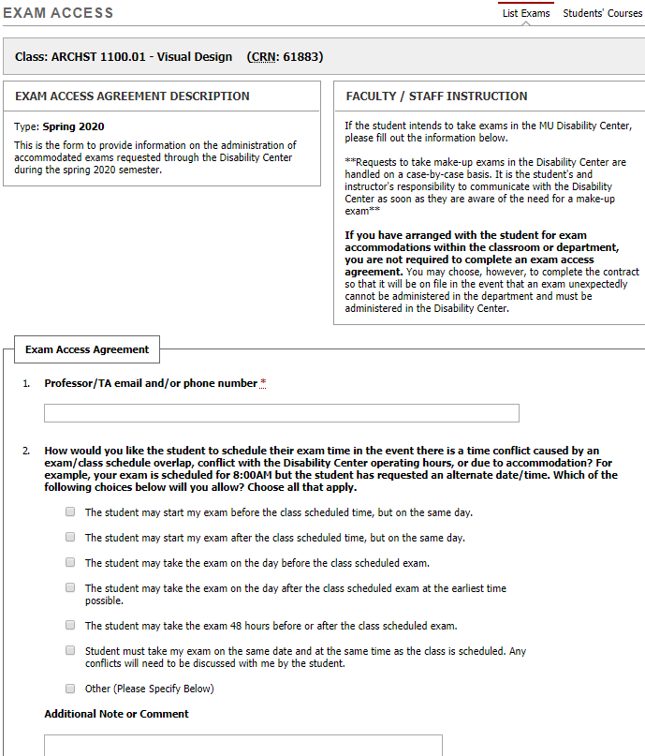
You will fill out the information asked and when finished, you will click on the “Submit Exam Access Agreement” at the bottom of the page.
It is important to complete the information as detailed and thoroughly as possible. You will be able to make updates/changes throughout the semester when needed. Any changes should be comminuted with the student and Disability Center to avoid any miscommunications when it comes to approving requests.
When this is completed, you can go back to the “Exam Access” section and if there are exam requests submitted by students you can upload your exams.

Slide 7
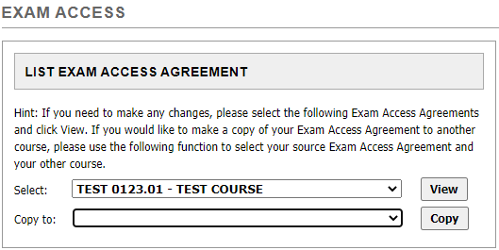
If you teach multiple sections of the same course, you can copy the Exam Access Agreement for all sections:
Go back to the Exam Access section
Select the course from the drop-down menu under “List Exam Access Agreement”
Select the section to copy it to then click on “Copy”

Slide 8
Now you’re ready to upload your exams…

Slide 9
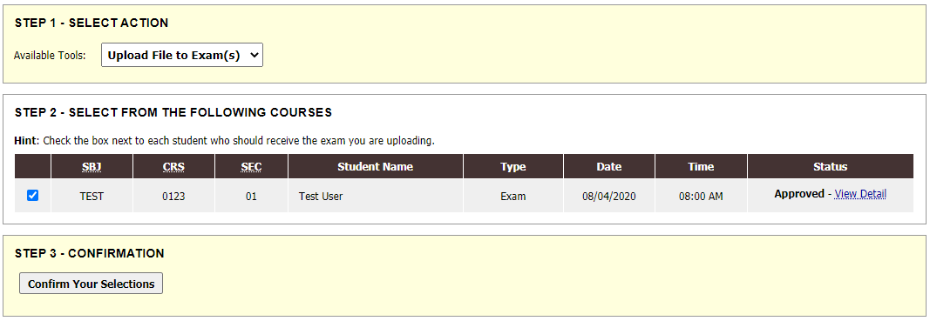
Click on all students who have an exam for the same day. For example if there are three students scheduled to take your exam on 8-4-20, you’d check the boxes by their requests and then click on “Confirm Your Selections”. It will allow you to upload the same file to all of those student’s requests.

Slide 10
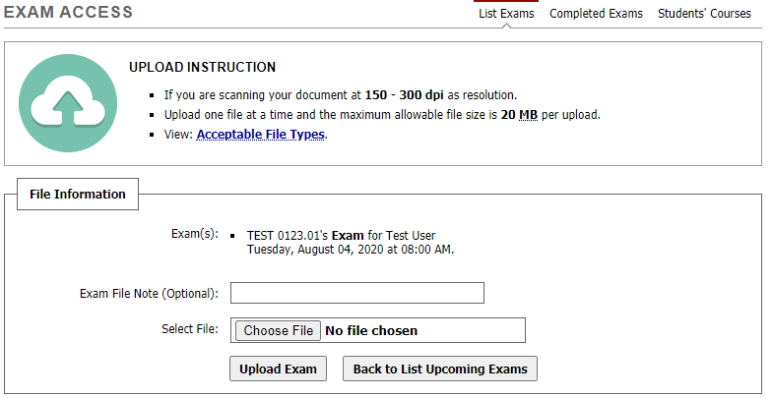
You can then upload your exam and the Exams Office will be able to download and print it for the student(s) taking your exam that day.
Tip: it’s very helpful if in the Exam File Note, you put the date of the exam (i.e. 9/15/20 Exam).

Slide 11
You can now go back to the “Exam Access” section and see that the file was uploaded.

Slide 12
If you have any questions or need assistance with this, please contact the Disability Center’s Exam’s Office and we will be happy to help.
Phone (573) 882-4698
Email: mudcexams@missouri.edu

