Slide 1

Volunteer Notetakers
A complete guide on how to to sign-up as a Notetaker with the MU Disability Center.

Slide 2

Thank You!
First off, we would like to say thank you for volunteering to be a Notetaker. You are helping to ensure equal access for students with disabilities, making it possible for them to participate fully in their education.

Slide 3
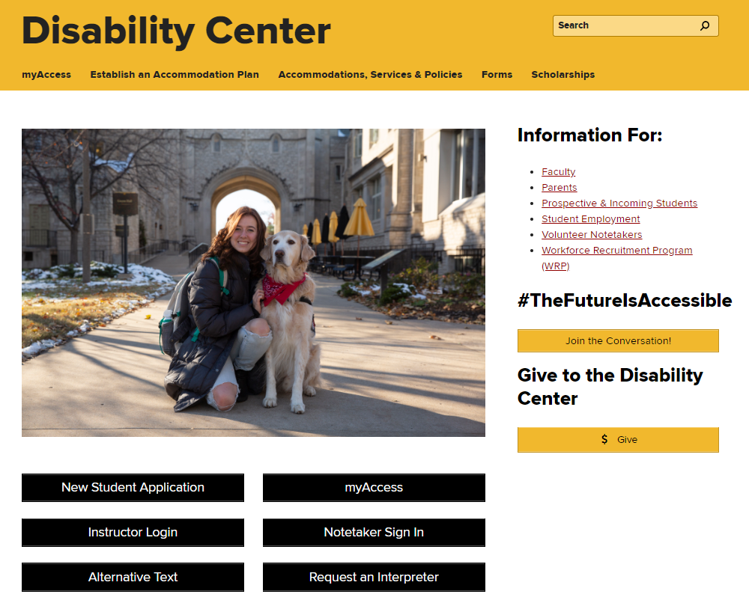

Step 1
Go to the Disability Center’s webpage; www.disabilitycenter.missouri.edu & click on the ‘Notetaker Sign In’ button.
You will be asked to login using your MU Pawprint and password.

Slide 4
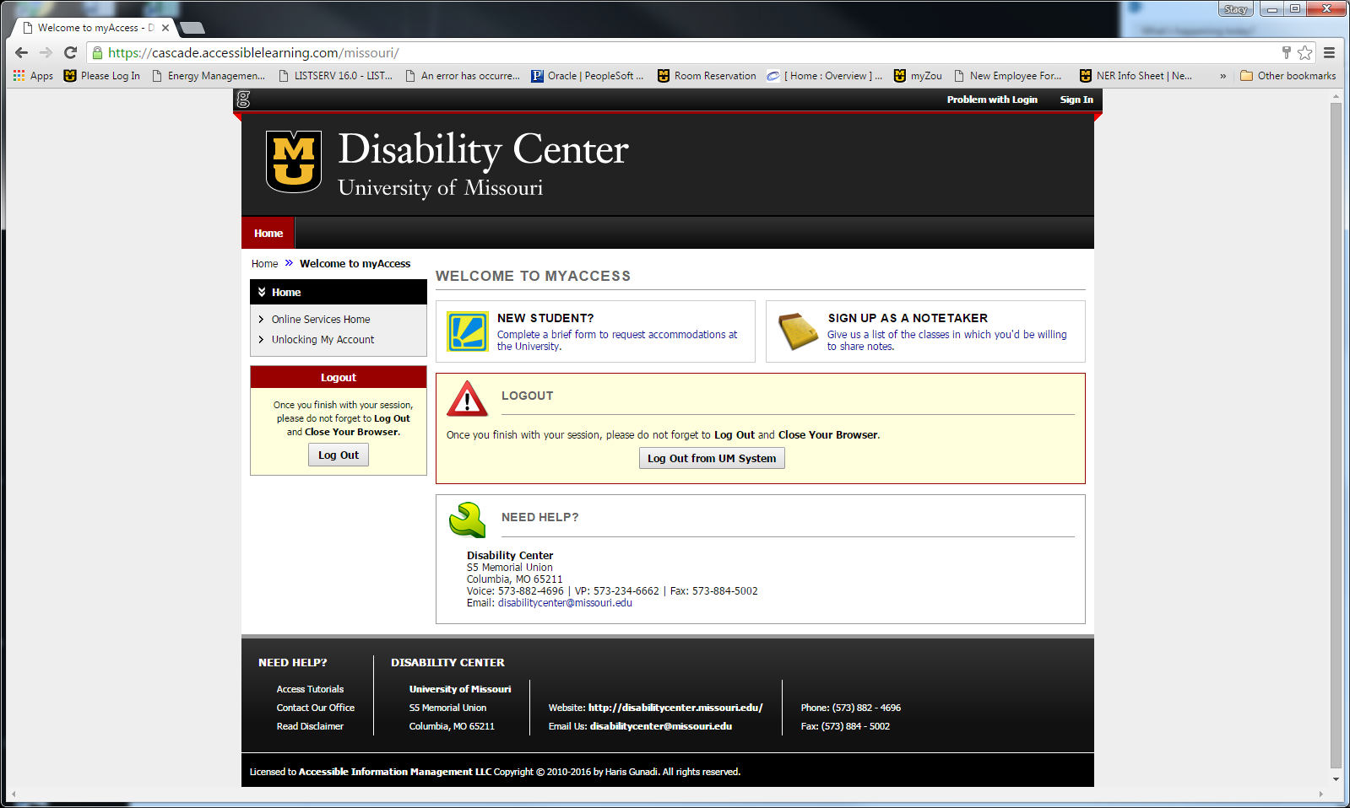

Click on “Sign Up as a Notetaker”.
Step 2
*If you are a returning Notetaker and already have an account established, you can skip to step 5 (slide 8).

Slide 5
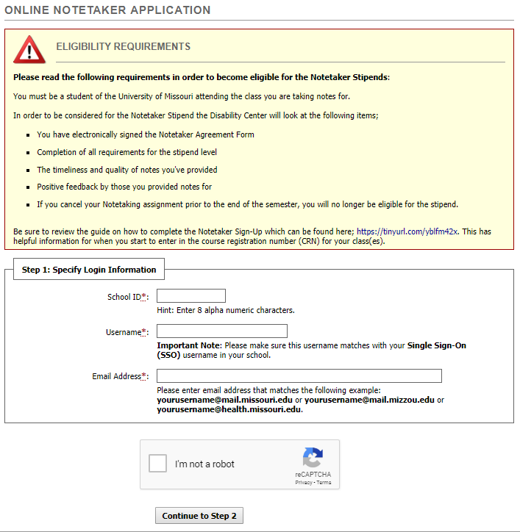

Read the Eligibility Requirements and then enter in the following:
-School ID#
-Username (Pawprint)
-Mizzou Email Address
Then type the series of letters and numbers shown in the reCAPTCHA section and click “Continue to Step 2”.
Step 3

Slide 6
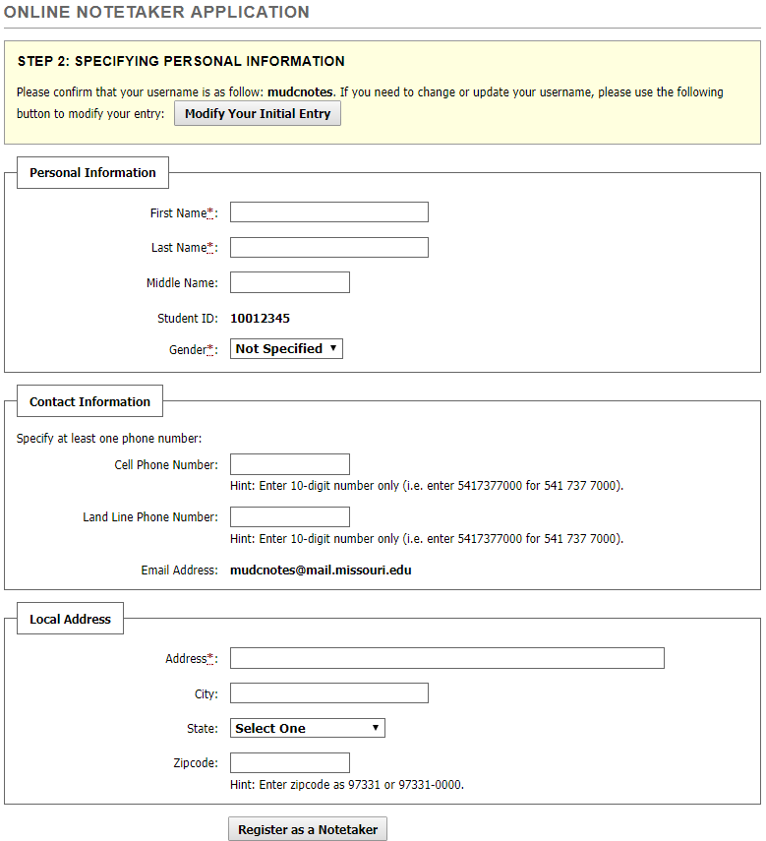

Step 4
Fill out the information within your Notetaker Application and click “Register as a Notetaker” when finished.
You’ll want to have the Course Registration Number for your class(es) that you wish to provide notes for. The next slide will show you how to obtain those CRNs.

Slide 7
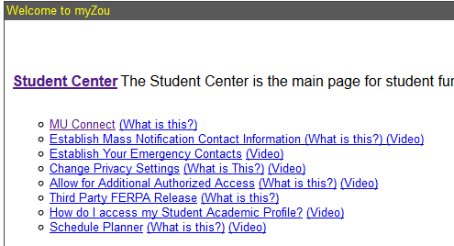
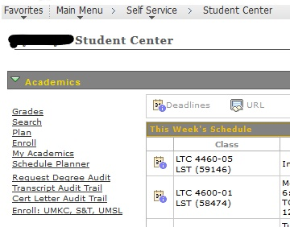

How to Find the Course Registration Numbers (CRN)
Here are the steps to find the correct Course Registration Number (CRN) for the class(es) you want to share notes for;
Log into your myZou account
Click on Student Center
Next to each of your classes will be a 5-digit number. This is the CRN you will enter to request a notetaking assignment.

Slide 8
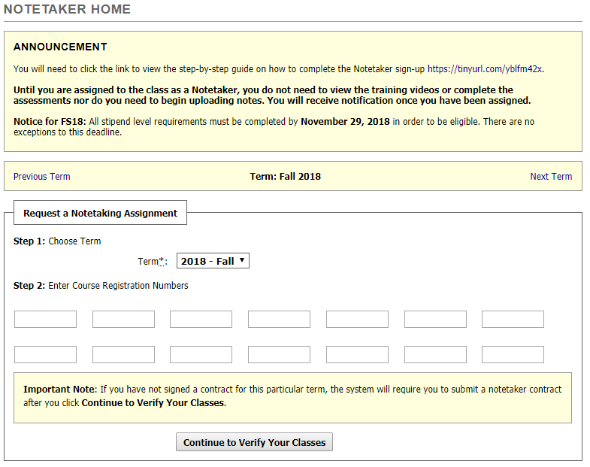

Step 5
Enter in the CRN for each course you are signing up for within the
“Request a Notetaking Assignment” section.
When you are done, click on
“Continue to Verify Your Classes”.

Slide 9
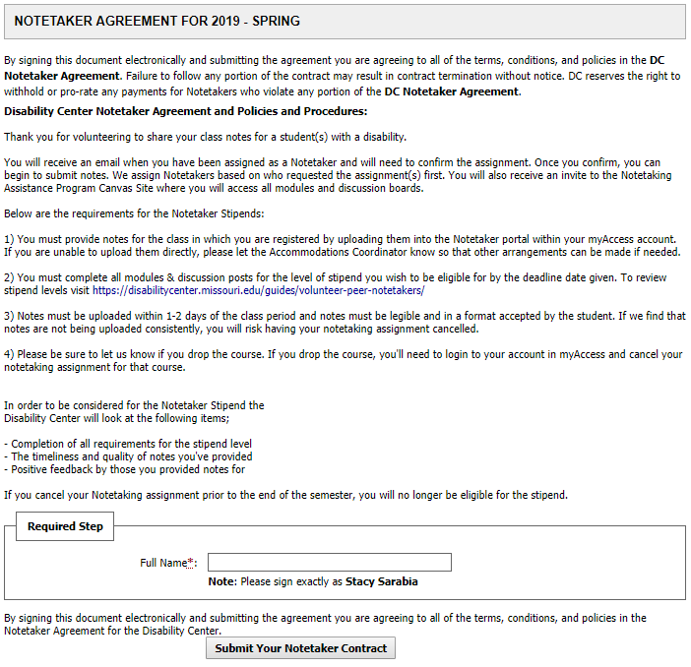

Step 6
Read the policies and procedures in the Notetaker Agreement before signing it.
When finished reading the agreement, type in your name at the bottom. Be sure to type it as it is shown below the “Full Name” box.
Click “Submit Your Notetaker Contract”.

Slide 10
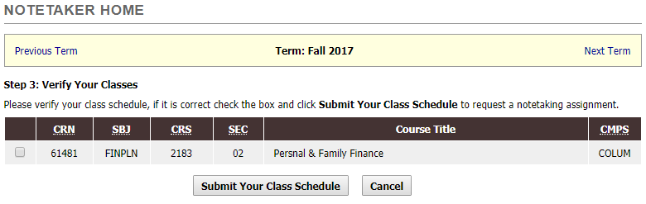

Step 7
Click the check box next to the course(s) you are volunteering for and click “Submit Your Class Schedule”.

Slide 11
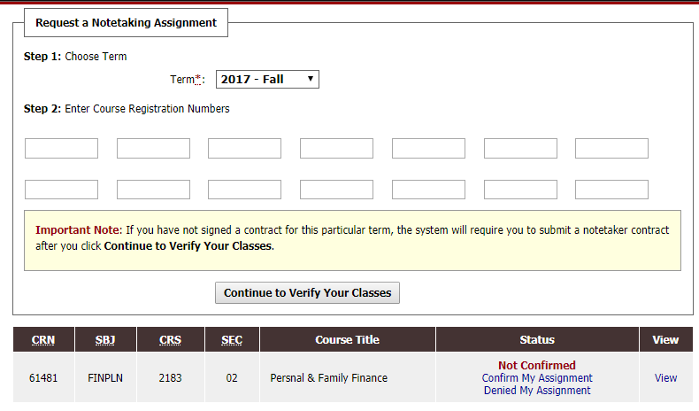

Step 8
Once you’ve submitted your classes, you’ll need to wait until you are matched and assigned to the class. You will receive an email once this is done. You will then need to log back in and confirm your assignment before notes can be submitted.
Under the section where you entered the CRN’s for your courses, you’ll see your assignments. You’ll need to click on Confirm My Assignment. If you deny your assignment you will be removed from this class and another volunteer will be assigned.

Slide 12
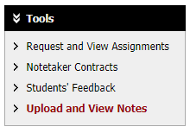

Step 9
After you’ve confirmed the assignment you should start uploading notes as soon as possible.
From your account, on the left-hand side of the screen you’ll see the “Tools” section. Click on “Upload and View Notes”, where you’ll be taken to the uploads section.
*Reminder: we ask that notes are submitted within 1-2 days after each class period (when applicable). If there are days where notes were not needed, you can email mudcnotes@missouri.edu to let us know.

Slide 13
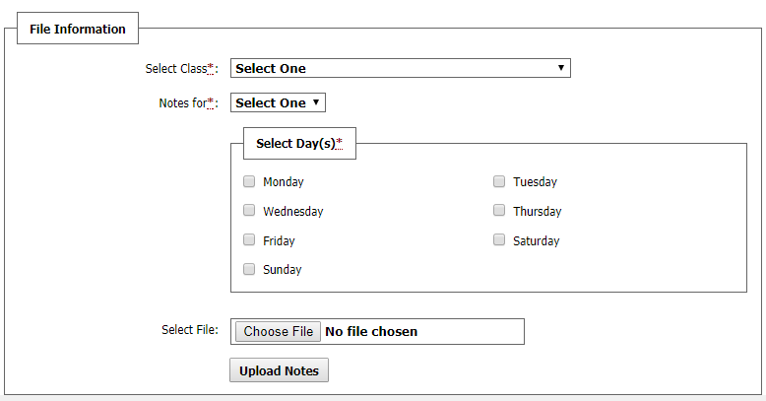

Step 10
Select the class you are uploading notes for from the drop down menu (if you are signed up for more than one class).
Choose which week they are for by clicking the drop down menu “Notes for*:”
Select the day of the week by clicking the box next to the days listed.
Click “Choose File” and find the notes that you want to upload then click “Upload Notes”.
Files cannot be more than 5 GB in size. If you take photos of your handwritten notes, be sure to use an app such as CamScanner that allows you to convert them into PDF files. This also helps cut down on file sizes.

Slide 14

Step 10 (continued)
Although we do not require notes to be typed, we prefer that they are as it is the most accessible to our students. If you choose to submit only handwritten notes, they must be legible and pages accurately labeled.
Note uploads are frequently reviewed and if needed, we will ask for them to be typed. If you are unable to type them, we will then have to ask for another volunteer to provide notes for that class. We must ensure that we are providing accessible and sufficient notes to our students.

Slide 15

Step 11
Once you are signed up and matched to a class, you’ll be added to the Volunteer Notetaker Canvas site where you can access and complete all modules that are required for the stipends as well as, read any announcements and review other information regarding the Volunteer Notetaker Program.

Slide 16

Canvas Modules
As part of being eligible for the stipends, not only are you required to provide consistent and sufficient notes, but you are expected to complete modules within the Notetaking Assistance Canvas page. Based on the level of stipend you are interested in, there are different requirements for those. You will learn about the levels on slide 17.
You will receive an email notification with an invitation to the Notetaking Assistance Program Canvas site once you’ve been assigned as a Notetaker. This is where all modules will be for you to complete.

Slide 17
Levels of Notetaker Stipends
There are two different options for stipend amounts that are available currently.
Stipends are sent out after the end of the semester and will either be mailed or direct deposited into your bank account.
Level 1 - $75 Stipend (1 class) & $100 (2+ classes):
Complete all modules by the deadline date.
Notes must be uploaded within 1-2 business days of the class period.
Notes must be legible and in a format accepted by the student.
Level 2 - $50 Stipend (1 class) & $75 (2+ classes):
Complete FERPA Training/Quiz, First-Steps module and the Notetaking Strategies module by the deadline date.
Notes must be uploaded within 1-2 business days of the class period.
Notes must be legible and in a format accepted by the student.
**Please note; stipends are based on the total number of courses notes were taken for, not per course.**

Slide 18
Questions?
Should you have any questions about the Volunteer Notetaker Program,
please feel free to contact the Accommodations Coordinator by email at mudcnotes@missouri.edu or call (573) 882-4696.

