Slide 1
Navigating Your myAccess Account

Slide 2
Purpose of this Tutorial
There are a variety of features within myAccess.
This tutorial provides an overview of the various features you will find within our system.
Should you ever encounter issues with our system, please contact the Disability Center at 573-882-4696 or disabilitycenter@missouri.edu

Slide 3
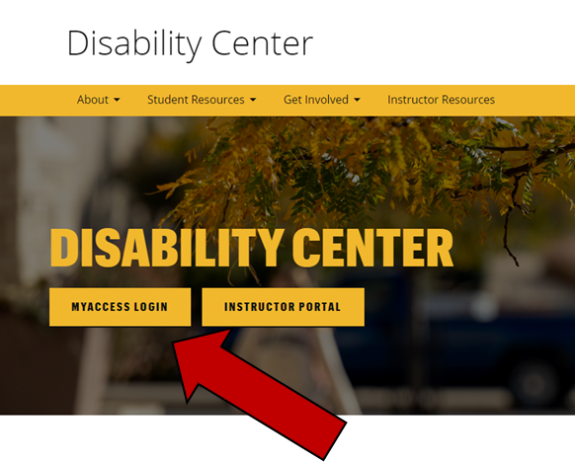
Accessing Your Account
To access your account, go to the Disability Center’s website; disabilitycenter.missouri.edu and click on the “myAccess Login” button.
You will be asked to login using your MU Pawprint and password.

Slide 4
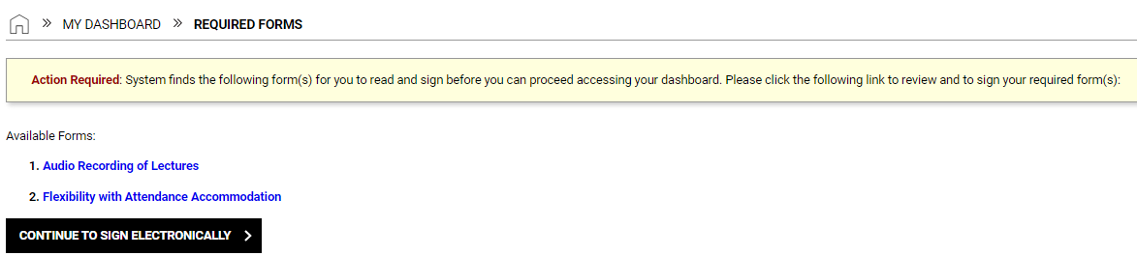
Required Electronic Forms
Each semester you will be prompted to read and electronically sign any required forms for the Disability Center.
Click on one of the forms and all forms will display.
Review the content and type your name in the “Your Consent” box verifying that you have read and understood the information.
Click “Submit Form” at the bottom of the page.

Slide 5
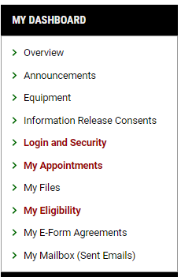
Required Electronic Forms, cont.
Need to refer to those electronic forms you signed?
You can find a copy of all electronic forms you’ve signed in the “My E-Form Agreements” section

Slide 6

My Eligibility
Need to look up the accommodations you are eligible for?
The ‘My Eligibility’ section lists all your approved accommodations.

Slide 7
My Mailbox
Emails from our office will go to your official MU email account.
Not sure if you’ve missed an email from us? The “My Mailbox” tab allows you to view most emails sent to you by the Disability Center.
The communications in the log include your Accommodation Plan, upcoming appointment reminders, communication regarding specific accommodations, etc.

Slide 8
Information Release Consents
By requesting accommodations in myAccess, you grant us permission to notify your instructor(s) of your accommodation(s).
Outside of that, if you would like us to share information regarding your accommodations or status with the office to either a parent/guardian, academic advisor, or other campus official/department, you’ll need to complete an “Informed Release Consent Form” found in myAccess.
NOTE: Completing a release does not grant the individual the ability to request accommodations on your behalf, nor does it mean we’ll actively reach out to parents/guardians about your involvement with our office.

Slide 9
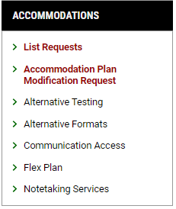
Listing Accommodation Request
To receive your accommodations each semester, you’ll need to confirm your need in myAccess.
Not sure if you’ve requested your accommodation letters, or want to confirm which accommodations you’ve requested?
Use the “List Requests” feature to view all your accommodation letters and/or to generate new letters.

Slide 10
Modifying Your Accommodation Plan
We realize that your accommodation needs may change throughout the course of your academic career.
If you need to request additional accommodations other than what you’ve already established, please complete the ‘Accommodation Plan Modification Request Form’ to start the process.
Your Access Advisor will review the information provided to determine your eligibility for the new accommodation(s).
If a follow-up appointment is necessary, they will contact you and schedule a time to discuss the request.

Slide 11
Alternative Testing, Alternative Formats, Flex Plans, & Note-Taking Assistance
Some accommodations require additional steps in myAccess to implement.
Depending on your eligibility, you may have access to additional modules in the system.
Additional information on how to utilize these modules can be found in the corresponding myAccess guide.

Slide 12
Questions?
If you have any questions, please contact the office Monday-Friday between 8am and 5pm.
(573) 882-4696 / disabilitycenter@missouri.edu

