Slide 1
Requesting Alternative Formats

Slide 2
About this Tutorial:
Alternative format accommodations are coordinated through MyAccess.
This tutorial provides an overview on how to request your alternative format accommodation, input your textbook information, track the status of your request, and how to access your materials after they’ve been converted.

Slide 3
Is this the first time you are using
Alternative Textbook Formats at Mizzou?
If yes - there is a one-time step to finish setting up the accommodation:
Schedule and meet with the IT Accessible Center for an Alternative Text Consultation.
The consultation is to determine the best match of digital format for you.
The IT Accessible Center will convert your books to the format that you decide on together.
To schedule your consultation with the IT Accessible Center, contact:
Jennifer Thornhill
Phone: (573) 884-8600
Email: ThornhillJ@missouri.edu

Slide 4
Step 1 - Request your accommodation letters
To request an alternative format accommodation, you first need to generate your accommodation letter(s) and check that you are wanting to use “Alternative Textbook Format”
Please see our “Requesting Accommodation Letters” guide for more information

Slide 5
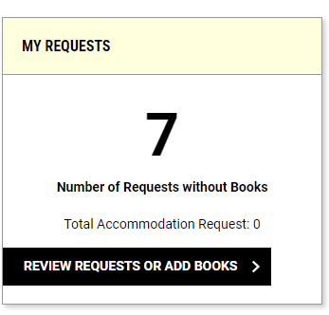
Step 2 - Navigate to the Alternative Formats module
Click on the “Alternative Formats” module in myAccess, located on the left-hand side of the screen.
click the “Review Requests or Add Books” button in the “My Requests” box

Slide 6
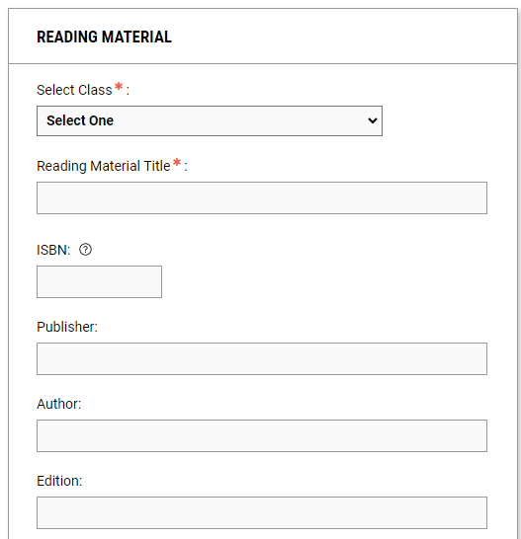
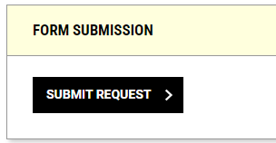
Step 3 – Enter your book information
In the “Reading Material” box, use the “Select Class” dropdown to indicate which course the book is for
Enter your book information and please include the following:
  Reading Material Title
  ISBN
    Please note the ISBN number is generally a 13-digit number starting with “978” located near the bottom of the book’s back cover
  Publisher
  Author
  Edition, if applicable
Click “Submit Request”

Slide 7
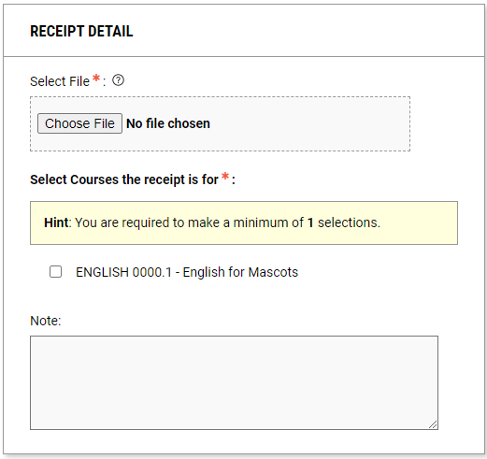
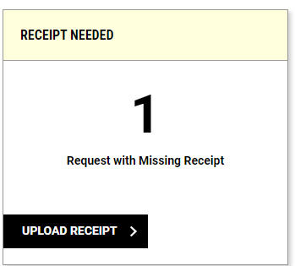
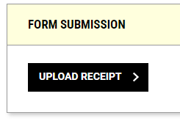
Step 4 - Provide receipts
Students must provide proof of purchase before books can be converted.
After you have entered your book information a new “Receipt Needed” box will show up within your Alternative Formats module
Click on “Upload Receipt” button and the insert the receipt file as well as select which book the receipt is for
Lasty, Within the “Form Submission” box, click “Upload Receipt”

Slide 8
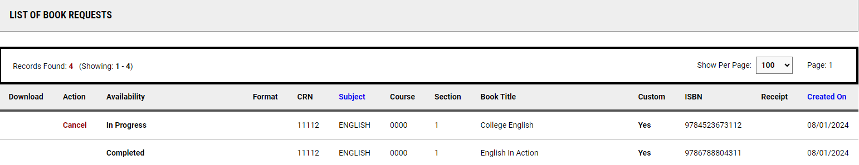
Checking your book status
After you have submitted your book information, they will show up in the “List of Book Requests” within the “Review Requests or Add Books” portion of the Alternative Formats module
This section is also where you can check the status of your books

Slide 9
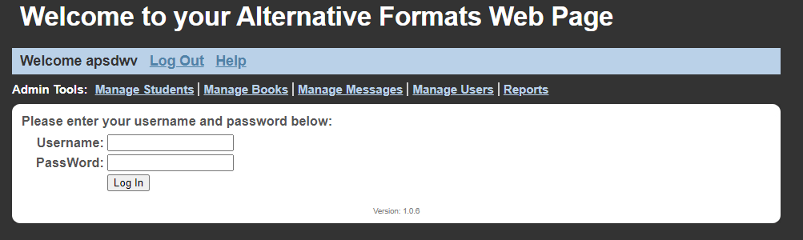
Step 5 - Download your alternative formats
Books marked as “Complete” can be download from the IT Accessibility Center’s Alternative Formats website
  Log in with your University username and password, click “View” next to the desired material and then “View File” to download

Slide 10
Questions?
If you have any questions regarding your alternative formats accommodation, please contact the Accommodations Coordinator
(573) 882-4696 / Disabilitycenterbooks@missouri.edu

