Slide 1
Volunteer Notetakers
A complete guide on how to to sign-up as a Volunteer Notetaker with the MU Disability Center.

Slide 2
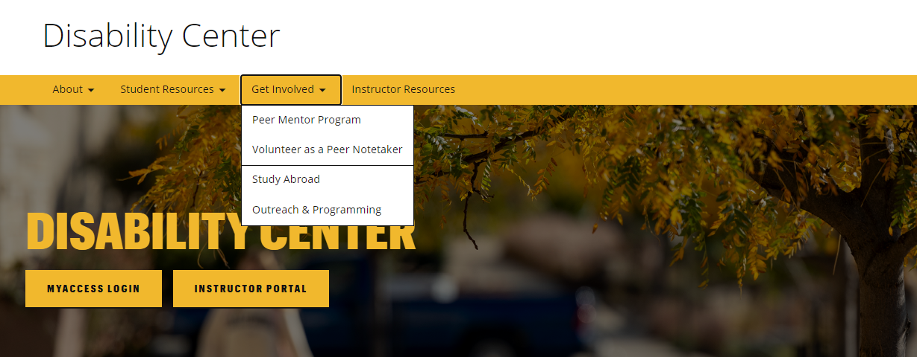
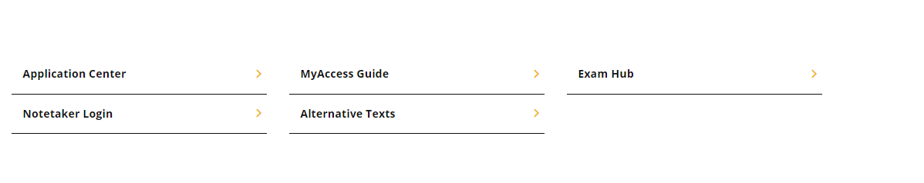
Step 1: Log into the Notetaker Portal
There are two ways to access the portal:
From the “Volunteer as a Peer Notetaker” site, found in the “Get Involved” tab
Using the “Notetaker Login” button further down on our homepage under our welcome message(s)
Regardless of the method used, you’ll be prompted to log into the system with your University Pawprint and password.

Slide 3
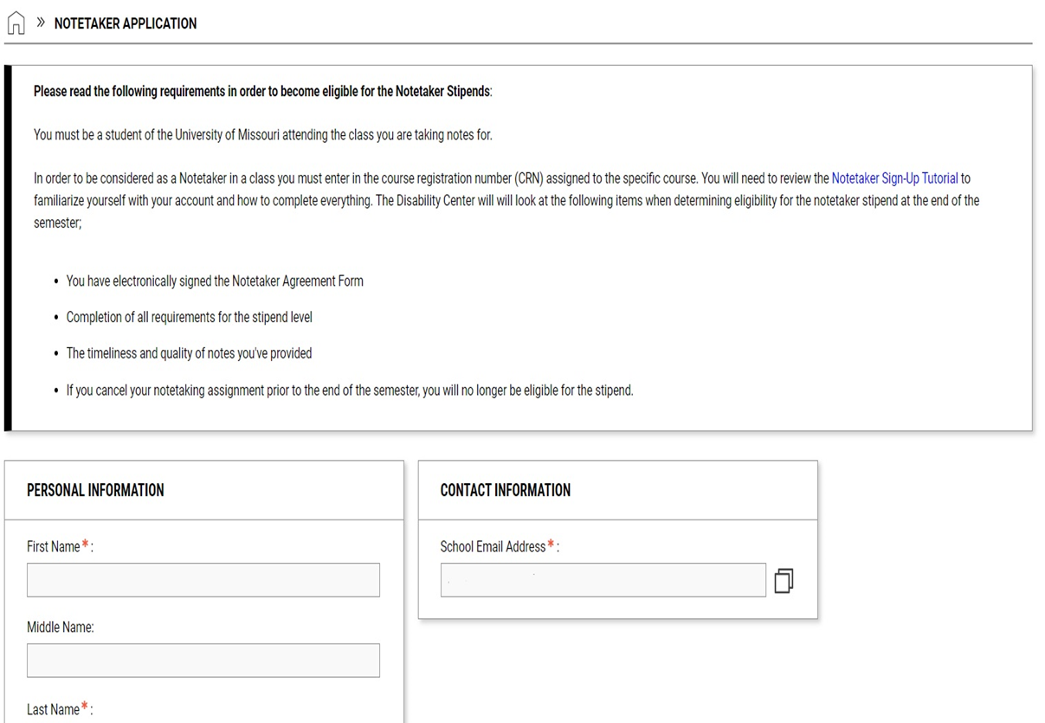
Step 2: Create your Notetaker Profile
If you have been a notetaker before and already have an account established, you can skip this step.
Read the Eligibility Requirements
Provide the following:
  First and Last Name
  Student ID#
  Mizzou Email Address
Click “Create Notetaker Account” in the bottom left-hand corner of the screen

Slide 4
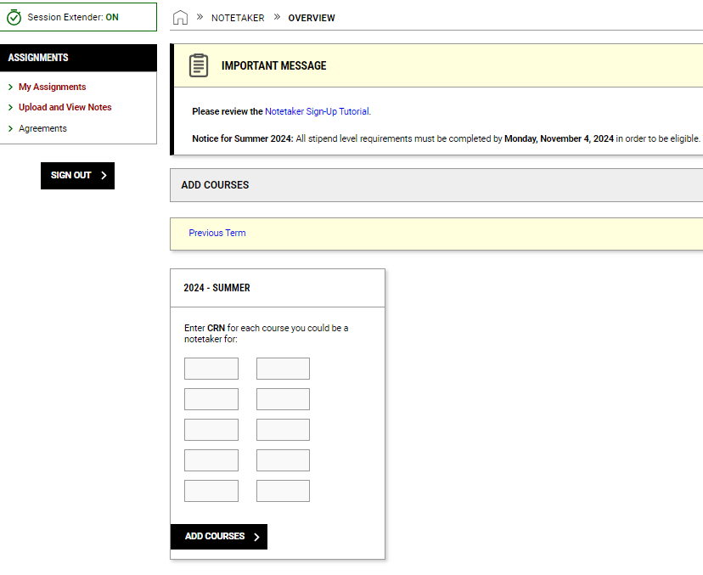
Step 3: Provide your course information
Once you’ve created a notetaker account, you will be directed to your main dashboard within MyAccess.
Click on the “Notetaker” tab on the left-hand side of the page
Enter the CRN for each course you are willing to serve as a peer notetaker and click “Add Courses”

Slide 5
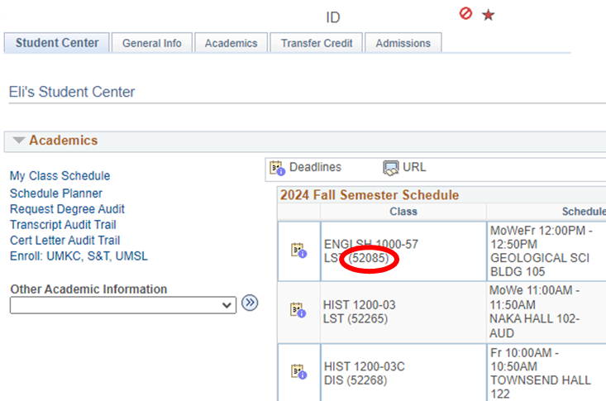
Finding your CRN
Log into your myZou account
Click on Student Center
Next to each of your classes will be a 5-digit number. This is the CRN you will enter to request a notetaking assignment.

Slide 6
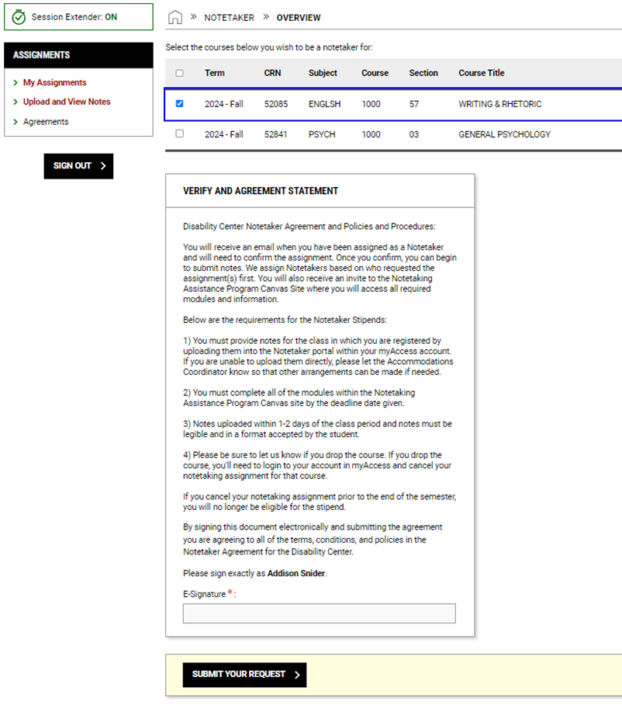
Step 4: Confirm and Sign Agreement
Check the boxes on the right-hand side next to the course(s) in which you are willing to share notes.
Read the Verify and Agreement Statement.
Type your name at the bottom.
  Be sure to type your name exactly as shown
Click “Submit Your Notetaker Contract”

Slide 7
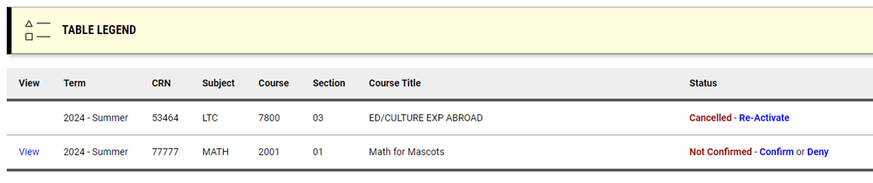
Step 5: Confirm your Assignment
If you are matched as a notetaker, you’ll receive an email to your Mizzou account.
To CONFIRM your assignment, log back into the Notetaker Portal and click “Confirm.”
  This step must be completed before you can upload any notes to the system.
If you DENY your assignment, you will be removed from this class and another volunteer will be assigned.

Slide 8
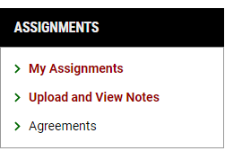
Step 6: Uploading Notes
After you’ve confirmed the assignment, you should start uploading notes as soon as possible.
From your account, on the left-hand side of the screen you’ll see the “Assignments” section.
Click on “Upload and View Notes,” where you’ll be taken to the uploads section.
Reminder: We ask that notes are submitted within 1-2 days after each class period (when applicable).
If there are days where notes were not needed, please email mudcnotes@missouri.edu to let us know.

Slide 9
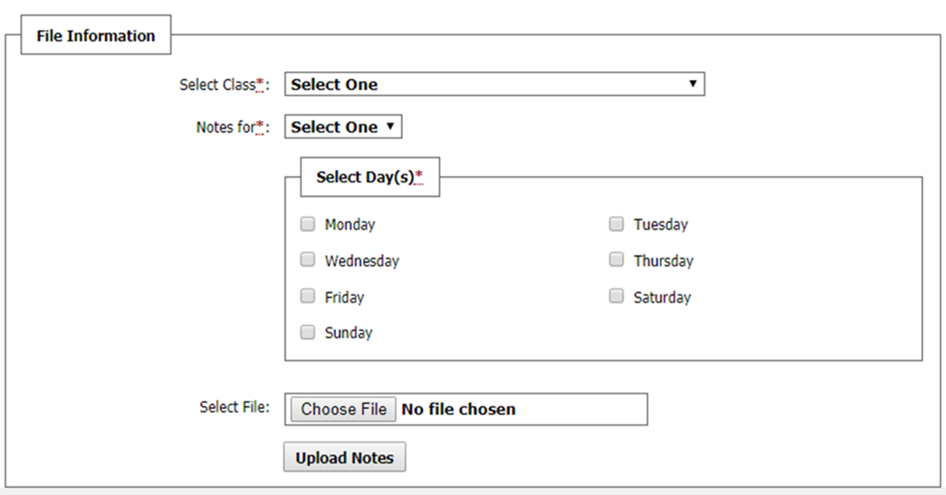
Step 6, continued
Select the class you are uploading notes for from the drop-down menu (if you are signed up for more than one class).
Choose which week they are for by clicking the drop-down menu “Notes for*:”
Select the day of the week by clicking the box next to the days listed.
Click “Choose File” and find the notes that you want to upload then click “Upload Notes”.
Files cannot be more than 5 GB in size.

Slide 10
Typing Notes
Although we do not require all notes to be typed, we prefer this method to ensure full accessibility.
  In certain situations, it is possible that typed notes will be required based on student accommodation needs.
If you choose to submit only handwritten notes, they must be legible and pages accurately labeled.
The notes you upload are frequently reviewed for quality. If needed, we will ask for you to type your notes.
  If you are unable to provide typed notes, we reserve the right to reassign the class to a different volunteer to ensure we are meeting the student’s accommodation needs.

Slide 11
Notetaker Stipend Eligibility
Eligibility for the Notetaker Stipend requires:
  Consistently uploading quality notes in a timely manner to the notetaker portal
  Completion of required trainings in the Canvas Notetaking Assistance Program
    You will receive an email notification with an invitation to the Notetaking Assistance Program Canvas site once you’ve been assigned as a Notetaker.

Slide 12
Notetaker Stipend Eligibility, cont.
Current stipend levels can be found on our “Volunteer to be a Peer Notetaker” website.
  Please note; stipends are based on the total number of courses notes were taken for, not per course.
Eligibility for a stipend is determined near the end of each semester.
  If eligible for a stipend, you will receive an email from the Student Affairs Business Office with instruction on what needs to be provided for your stipend deposit.
Stipends are sent out after the end of the semester and will either be mailed or direct deposited into your bank account.

Slide 13
Thank You!
Thank you for volunteering to be a peer notetaker.
You are helping to ensure equal access for students with disabilities, making it possible for them to participate fully in their education.

Slide 14
Questions?
Should you have any questions about the Volunteer Notetaker Program, please feel free to contact the Accommodations Coordinator by email at mudcnotes@missouri.edu or call (573) 882-4696.

