Slide 1
Instructor Portal Tutorial

Slide 2
Purpose of this Tutorial
There are a variety of features within the Instructor Portal.
This tutorial provides an overview of the various features you will find within our system, including:
  Viewing Students with Accommodations
  Alternative Testing
  Flex Plans
  Notetaking Assistance
  Adding Additional Instructors
Should you ever encounter issues with our system, please contact the Disability Center at 573-882-4696 or disabilitycenter@missouri.edu

Slide 3
Instructor Portal Basics

Slide 4
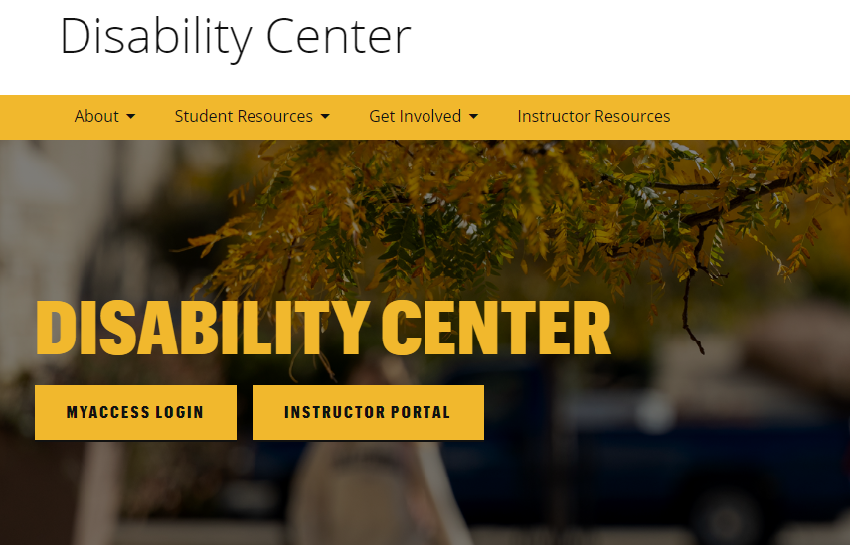
Finding the Instructor Portal
You can find a button directing you to the Instructor Portal on our homepage.
To log in, use your UM System username and password.

Slide 5
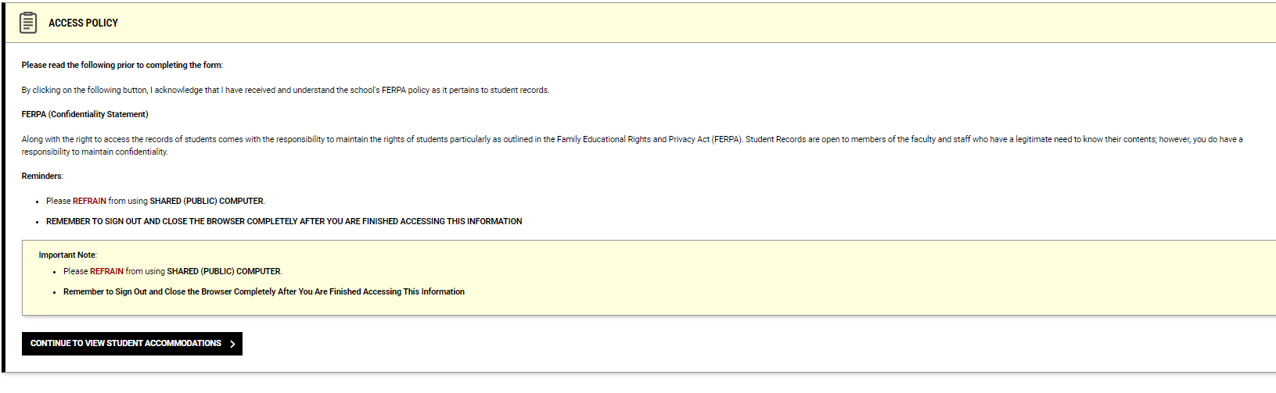
Reminder about Confidentiality
Each time you log into the Instructor Portal, you’ll be prompted to review our confidentiality agreement.
Upon review, you can click on the “Continue to View Student Accommodations” button to proceed to the Portal.

Slide 6
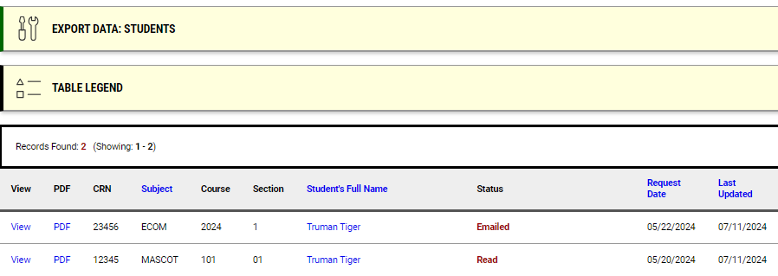
Overview:
Viewing Student Accommodations
The overview page provides a list of student(s) in your class(es) who have requested accommodations.
To view a copy of their accommodation letter, click on “View.”
  A copy of their accommodation letter will also be emailed to your UM System address.
You can use the “Export Data” feature to export a list of students and their accommodations.

Slide 7
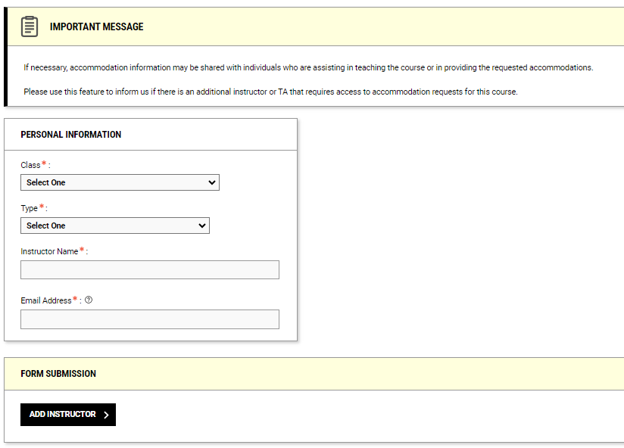
Adding Additional Instructors
The Instructor Portal utilizes the information within myZou to populate course instructors.
However, if you require accommodation information to be shared with another instructor not on record, you may do so by submitting a request using the “Add Instructor” feature.

Slide 8
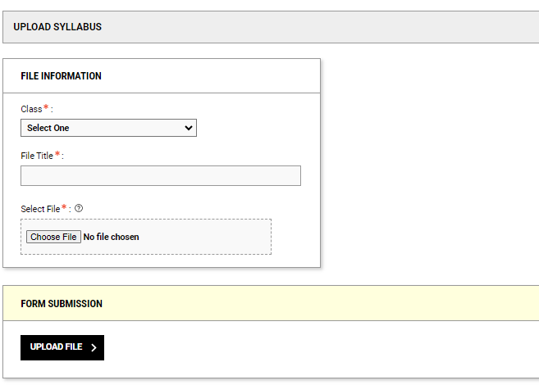
Uploading your Syllabus
While not always required, having a copy of your syllabus can assist us in better supporting you and the student(s) receiving accommodations in your class.
In certain situations (e.g. flex accommodations) we ask that you provide a copy to assist us in helping you determine the reasonability of the accommodation.

Slide 9
Alternative Testing Module

Slide 10
Alternative Testing
Faculty who are unable to provide exam accommodations can arrange for the Disability Center to administer exams on their behalf.
The Alternative Testing Module allows faculty to provide us with relevant information about their exam(s) so that we can provide this support.

Slide 11
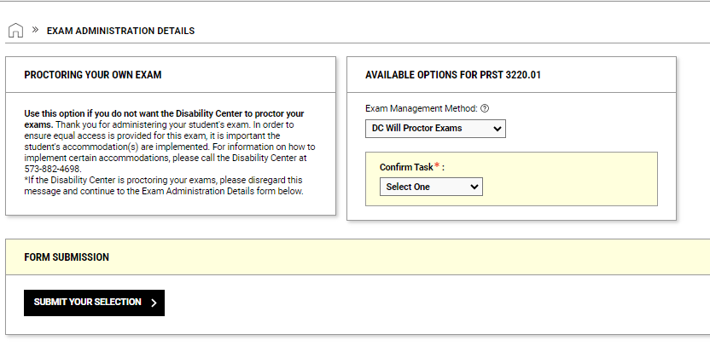
Exam Administration Details
Our Exam Administration Details section of the module allows you to provide pertinent information about your exams.
To begin, please confirm if you require our office to proctor your accommodated exams.

Slide 12
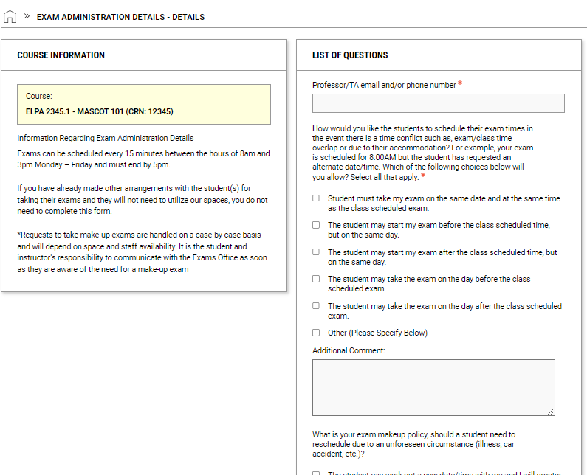
Exam Administration Details, Continued
You will be asked to complete an “Exam Administration Details” form for each class you teach.
After answering the questions, click the “Submit and Continue to Specify Exam Dates” button at the bottom of the page.

Slide 13
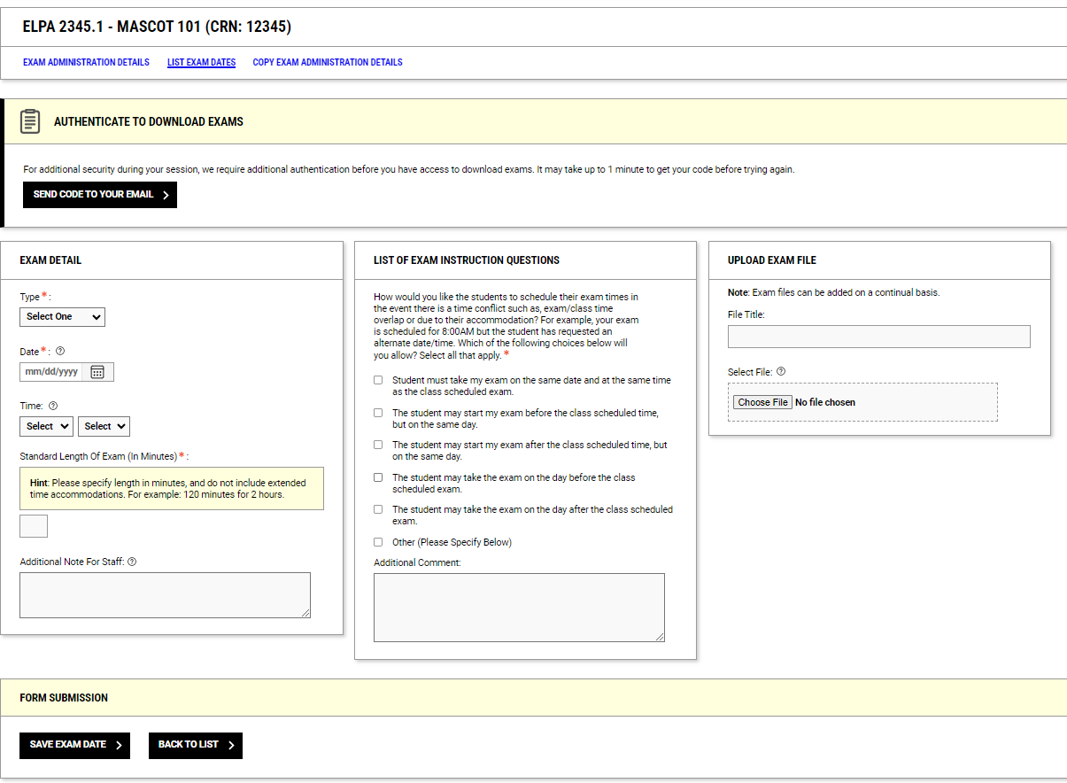
Providing Exam Dates and Times
The final step is to provide us with your exam dates and times.
Within this section, you can also upload a copy of your exam.
  Not ready to provide us your exam? You can always return to this page by viewing or modifying the exam administration details.

Slide 14
Flex Plan Module

Slide 15
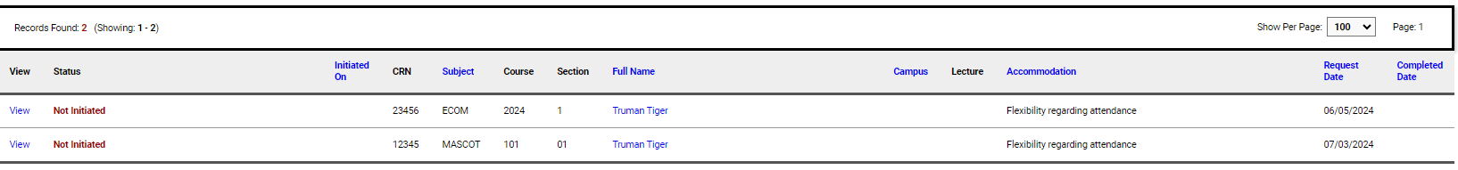
Creating Flex Plans
Clear communication is critical in ensuring flex accommodations are implemented appropriately. To that end, we ask all faculty to complete a “Flex Plan” with our office when they have student(s) with this accommodation.
If a student in your class has a flex accommodation, you will receive an email asking you to complete a Flex Plan.
On the left-hand side of the Instructor Portal, click “Flex Plan”
  This will open the Flex Plan module where you can see a list of all students who have requested flex attendance or flex deadline accommodations.

Slide 16
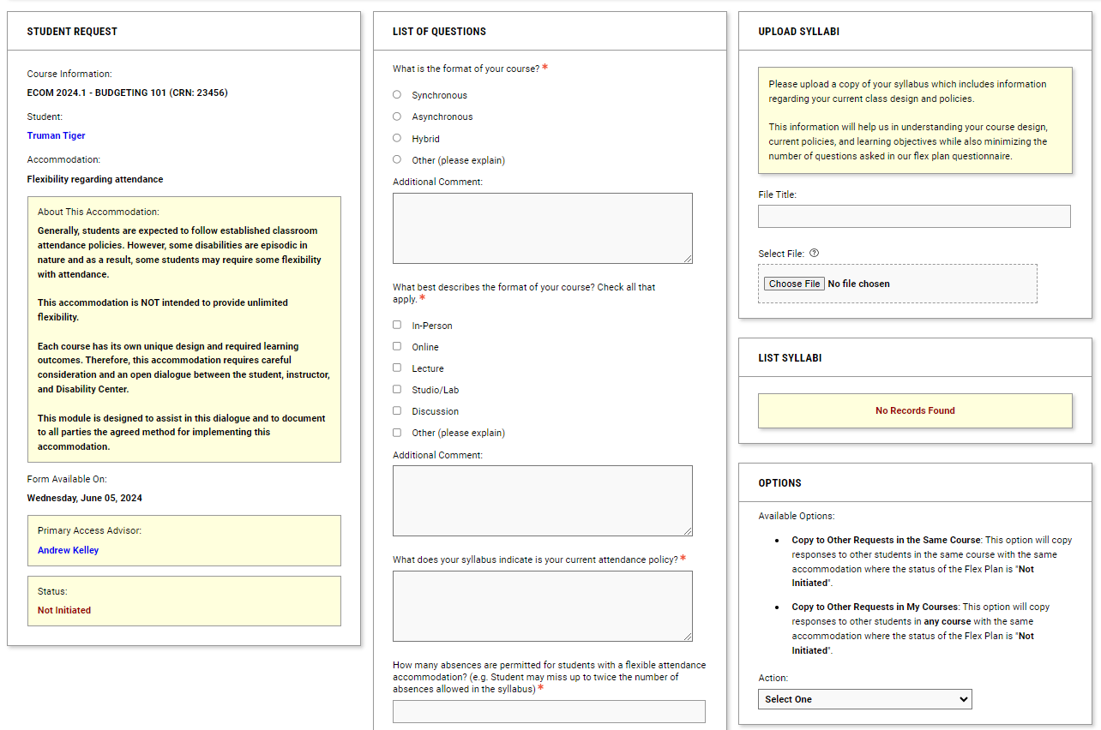
Flex Plan Module, Continued
By clicking on “View” next to the student’s name, you’ll open the Flex Plan questionnaire.
Please answer the questions listed and upload a copy of your syllabus.
Once finished, click the “Initiate and Request Review” button at the bottom of the page.

Slide 17
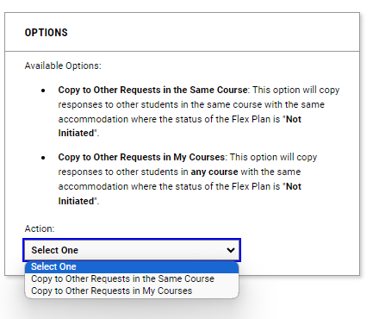
Flex Plans, Continued
Once submitted, our staff will review your flex plan.
After your plan is finalized, the information will be shared with the student and a record of the plan can be found in the Instructor Portal.
If you have multiple students requesting the same accommodation in your course(s), you can choose to copy the plan to these other students using the options feature within the flex plan questionnaire.

Slide 18
Notetaking Services Module

Slide 19
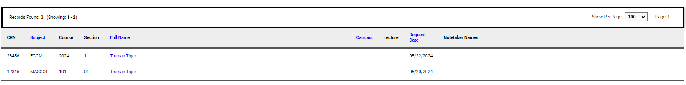
Notetaking Services
In this section, you can see if your class has a request for a notetaker and/or if there is already one assigned.
You can also view any notes that have been uploaded by the notetaker.
These notes will be visible for all students who have requested a peer notetaker in that class.

Slide 20
Questions?
If you have any questions, please contact the office Monday-Friday between 8am and 5pm.
(573) 882-4696 / disabilitycenter@missouri.edu

