Slide 1
Requesting Exams in myAccess
This tutorial will guide you on how to enter in exam requests if you plan to take your exams with the Disability Center.

Slide 2
Exam Policies and Procedures
All non-final exam/quiz requests must be submitted at least 7 days in advance during the fall and spring semesters. At least 5 days notice for exams/quizzes during the summer.
There is a separate deadline date for scheduling exams during weeks 15 and 16. The exams office will send out the deadline date and reminders for that deadline throughout the semester.
  When able, we recommend you schedule all your exams at once so you don’t need to worry about our deadlines!
Updated information about exam policies and procedures can be found on our website: https://disabilitycenter.missouri.edu/student-exam-information/

Slide 3
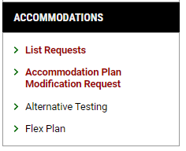
Step 1:
Accessing the Alternative Testing Module
Go to the “Alternative Testing” section in your myAccess Account.
This can be found on the left-hand side of your dashboard under “Accommodations”

Slide 4
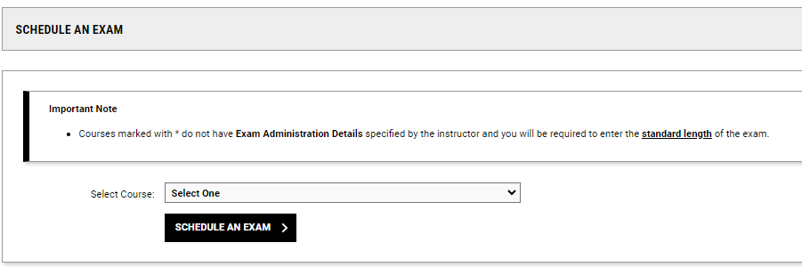
Step 2: Select the Course
Use the drop-down menu under “Schedule an Exam” to select the course you have an exam in
Click the “Schedule an Exam” button to proceed

Slide 5
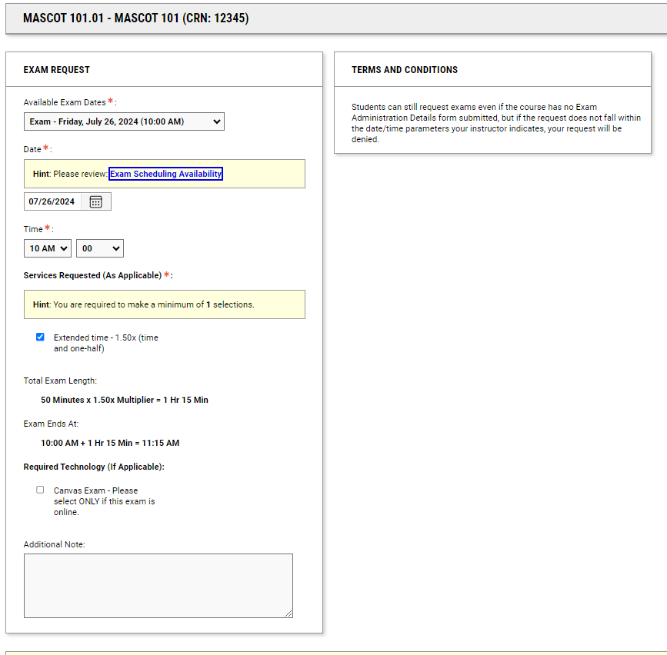
Step 3:
Request your Exam
Use the “Exam Request” feature to provide us with exam dates, times, and to confirm which of your accommodation(s) you’ll need for the exam.
Note: Exam information is provided by your instructor. If details are not available in the drop-down menu, please complete to the best of your ability and we’ll confirm details with your instructor.

Slide 6
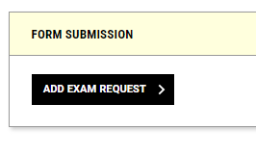
Step 4: Submit your request!
Once you’ve provided all your exam information, click the “Add Exam Request” button to submit!

Slide 7

Checking your Exam Status
The status of your exam request (e.g. pending, approved, completed) is tracked in the Alternative Testing Module.
You can view this and your assigned exam location by selecting the “All Exam Request” tab at the top of the module.

Slide 8
Questions?
If you have more questions about exams or exam scheduling, contact the Exams Office.
Email: disabilitycenterexams@missouri.edu
Phone: (573) 882-4698

