Slide 1
Accommodation Notification Letters & Requests for Additional Accommodations

Slide 2
About this Tutorial:
You are responsible for requesting your accommodation letters each semester you need to use them.
This tutorial provides an overview of the steps necessary to generate your accommodation letters.

Slide 3
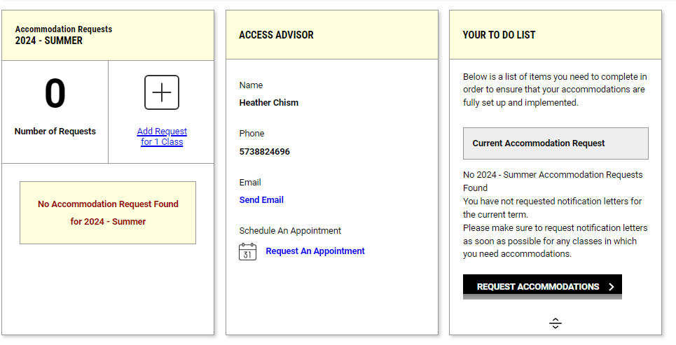
Steps to Generate your Accommodation Notification Letters
If it is your first time logging into myAccess for the current semester, you will be required to read and electronically sign e-forms pertaining to specific accommodations. Please see the guide under “Your myAccess Account” for information on this step.
To request accommodation letters, you can either select the “Add Request for # Class” under the current semester or the “Request Accommodations” button in your to-do list.

Slide 4
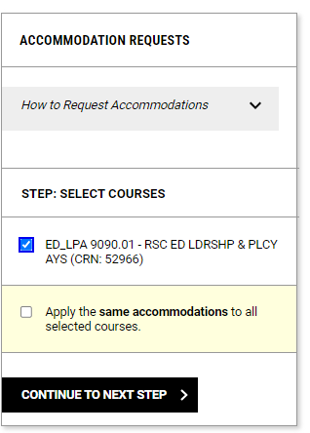
Steps to Generate your Accommodation Notification Letters (cont.)…
Select the course(s) in which you need accommodations and click “Continue to Next Step”

Slide 5
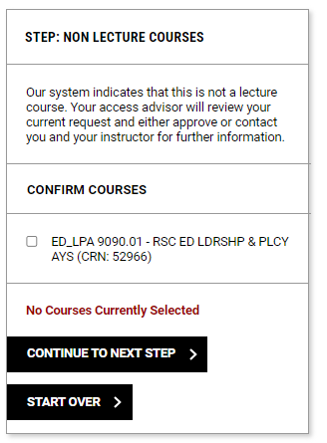
Non-Lecture Courses
Note: If you select a non-lecture course (e.g. discussion, lab, practicum) you may receive an prompt asking about your need to utilize accommodations for non-lecture courses.
If you need accommodations in these courses, you’ll need to reselect the course and click “Continue to Next Step”

Slide 6
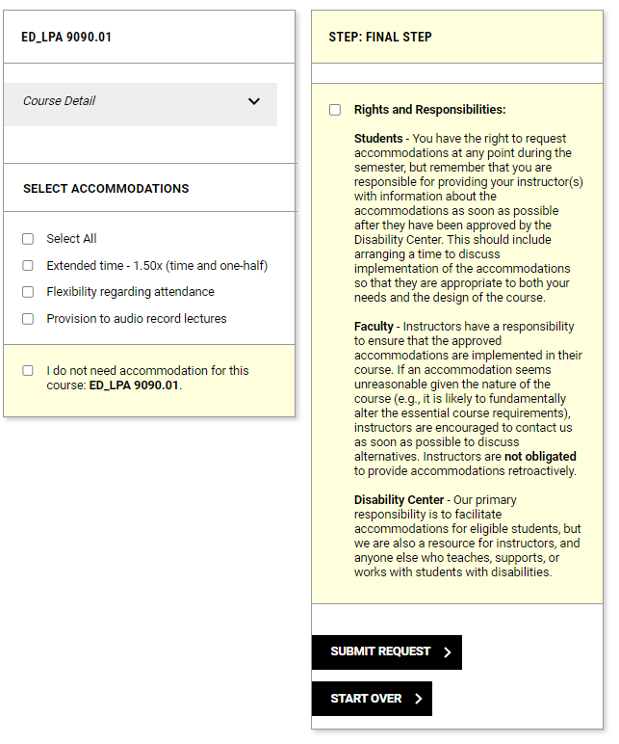
Selecting your Accommodations
Select all accommodations you need for the course(s) listed on the final page.
Review the “Rights and Responsibilities” section and click the box to acknowledge understanding.
Click the “Submit Request” button to generate your accommodation letters.

Slide 7
Notifying your Instructors
Your accommodation notification letters will be emailed to your instructors:
  Within 2-business days by the Disability Center if requested during the semester.
  Two weeks prior to the semester beginning if requested outside of the current semester.
Some accommodations require approval by your access advisor each semester and will list as “Pending” until approved.
Remember! Once you have requested your accommodations, arrange a time to meet with each instructor and discuss the specific details of implementing your accommodations.

Slide 8
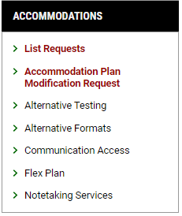
Modifying Your Accommodation Plan
We realize that your accommodation needs may change throughout the course of your academic career.
If you need to request additional accommodations other than what you’ve already established, please complete the ‘Accommodation Plan Modification Request Form’ to start the process.
Your Access Advisor will review the information provided to determine your eligibility for the new accommodation(s).
If a follow-up appointment is necessary, they will contact you and schedule a time to discuss the request.

Slide 9
Questions?
If you have any questions, please contact the office Monday-Friday between 8am and 5pm.
(573) 882-4696 / disabilitycenter@missouri.edu

